Slide 1
Week 7: Linear Regression Continued

Slide 2
Warm-Up Exercise
Either together or with a friend or enemy, interpret these results in ’plain English’ – if you had to present it to the mayor or my mom.
We are modeling Rates of Respiratory Disease in cities as a function of pollution levels and population density.
Variable | Coefficient | Standard Error | t-value | p-value
Intercept | 2.50 | 0.30 | 8.33 | <0.001
Pollution Levels | 0.75 | 0.12 | 6.25 | <0.001
Population Density | 0.35 | 0.08 | 4.38 | <0.001

Slide 3
Interaction Variables (As promised!)
Tells us something about the combined effects of two variables.
Pollution levels * Population Density
Effects of pollution on respiratory diseases enhanced by population density. The impact of pollution is stronger in areas with high pop. dens.
Variable | Coefficient | Standard Error | t-value | p-value
Intercept | 2.50 | 0.30 | 8.33 | <0.001
Pollution Levels | 0.75 | 0.12 | 6.25 | <0.001
Population Density | 0.35 | 0.08 | 4.38 | <0.001
Pollution * PopDens | 0.40 | 0.15 | 2.67 | 0.008

Slide 4
Let’s work through another wake-up warm-up example.
Regression using the auto dataset. Use all predictors and do diagnostic tests.

Slide 5
Resampling Techniques

Slide 6
Cross-Validation
test-error rate – an average error that results from using a statistical learning method (like regression) to predict the response on a new observation. A measurement NOT used in training the mode.
low test-error is good!
training error rate – apply the learning method to observations used in the training. Can very much underestimate.

Slide 7
Validation
Class of methods that estimate the test error rate by holding out a subset of the training observations from the fitting process.
Randomly divide the available data into two parts:
training
validation (hold-out set)
Fit model on training set. Use fitted model to predict responses for observations in validation set.
The resulting validation error rate (MSE) is an estimate of test error rate.

Slide 8
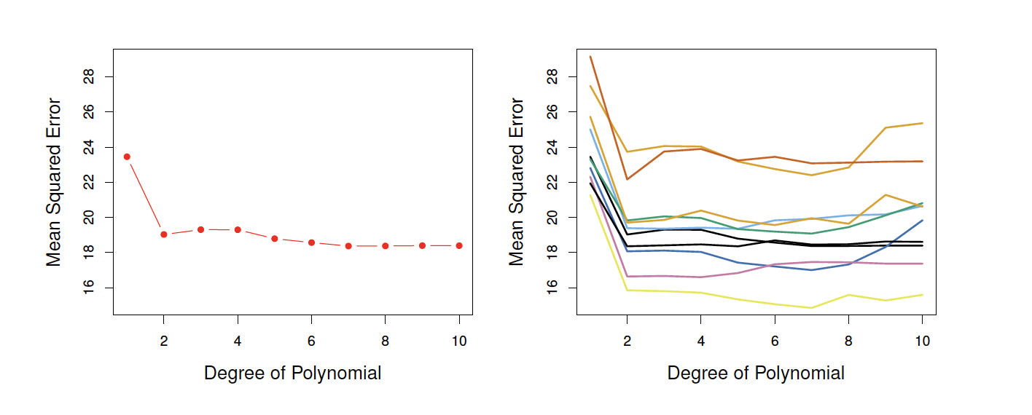

Slide 9
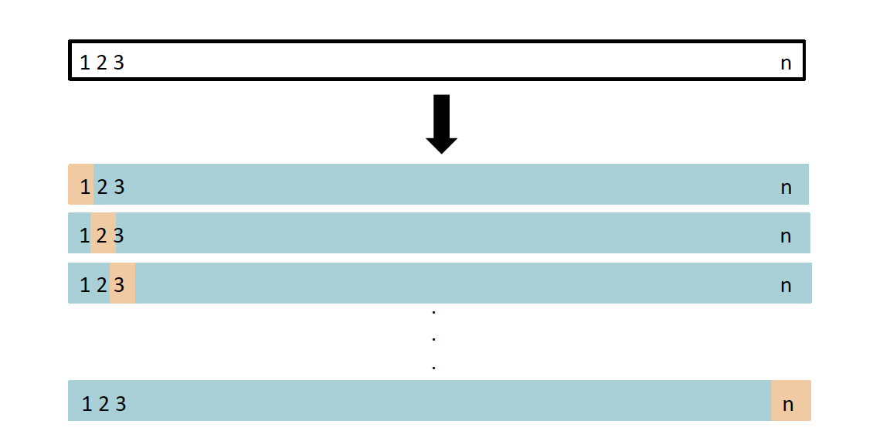
Leave One Out Cross Validation (LOOCV)
Leave out a single observation and use that for the validation.
The remaining obs. are used for the training.
Repeat.
Sum up the squared errors.

Slide 10
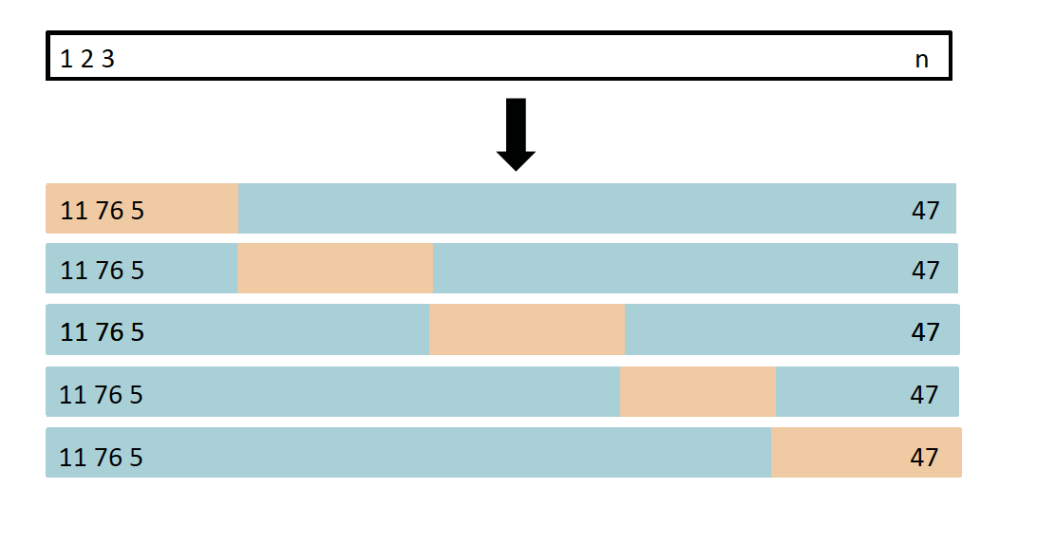
k-Fold Cross Validation
Randomly divide obs. into k folds (groups) of equal size.
The first fold is the validation set.
Fit the method on the remaining k-1 folds.
MSE is computed on the obs. in the held-out group.
Repeated k-times.
Take average of the k test errors

Slide 11
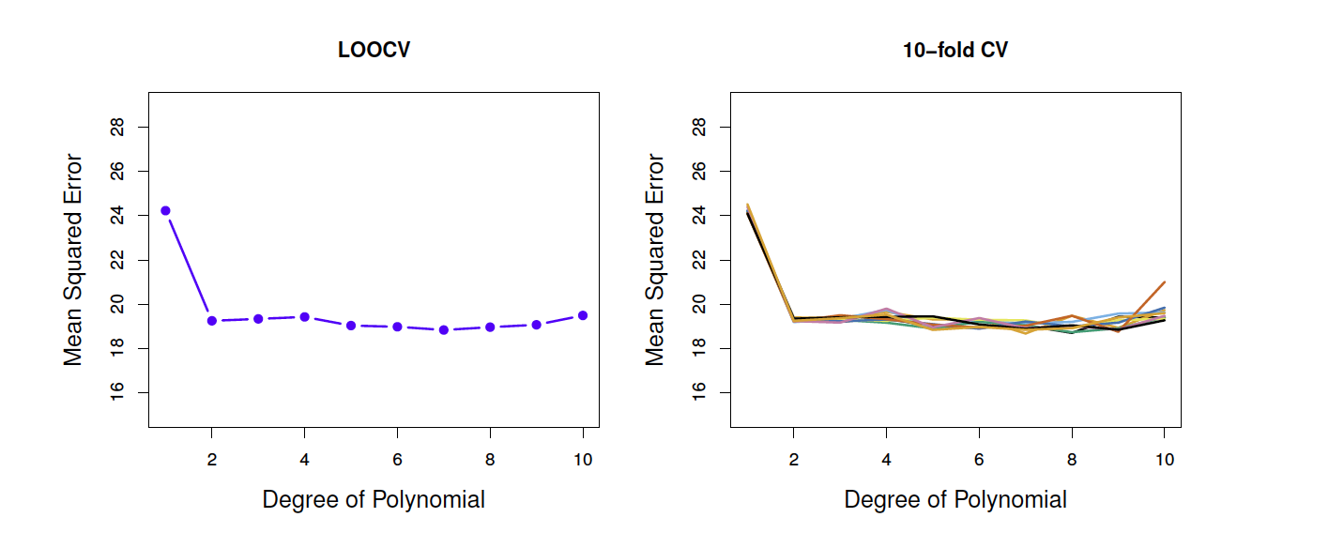
They perform similarly well
The give a sense of how generalizable our model results are for different samples

Slide 12
Let’s Practice.

Slide 13
Spatial Machine Learning
Hedonic Model Illustrative Example

Slide 14

Hedonic Model
The Price of a House
Structural Components
+
The Land (Location)

Slide 15
Modeling the Location Cost
Add Geographic Features
Distance to Various Amenities (Waterfronts, Parks)
Could think about modeling dis-amenities – what lowers property values?
Sometimes things are un-measurable! (Cool Neighborhoods)
Sometimes we use proxies for things that we really want in our model.

Slide 16
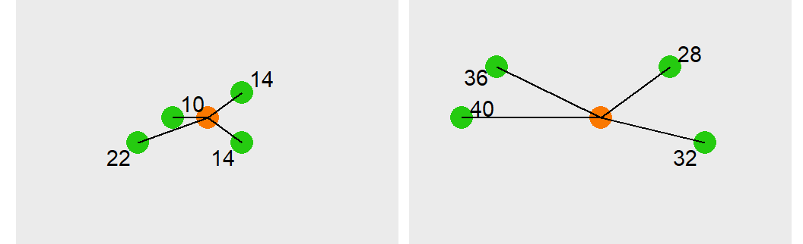
Modeling Spatial Features
k-Nearest Neighbors
Average distance to k (you pick k, the number of obs) events.
If kNN is small, things are close by. If the average distance is big, they are far away.

Slide 17
Group-Based Dummy Variables
‘Fixed Effect’
Encompassing variable to capture all the similarities of observations that may belong to the same group:
homes in a neighborhood,
children in a grade level,
countries in a region of the world
Use as.factor() in R to turn a variable into a category. as.factor(gradelevel)

